Slide 1
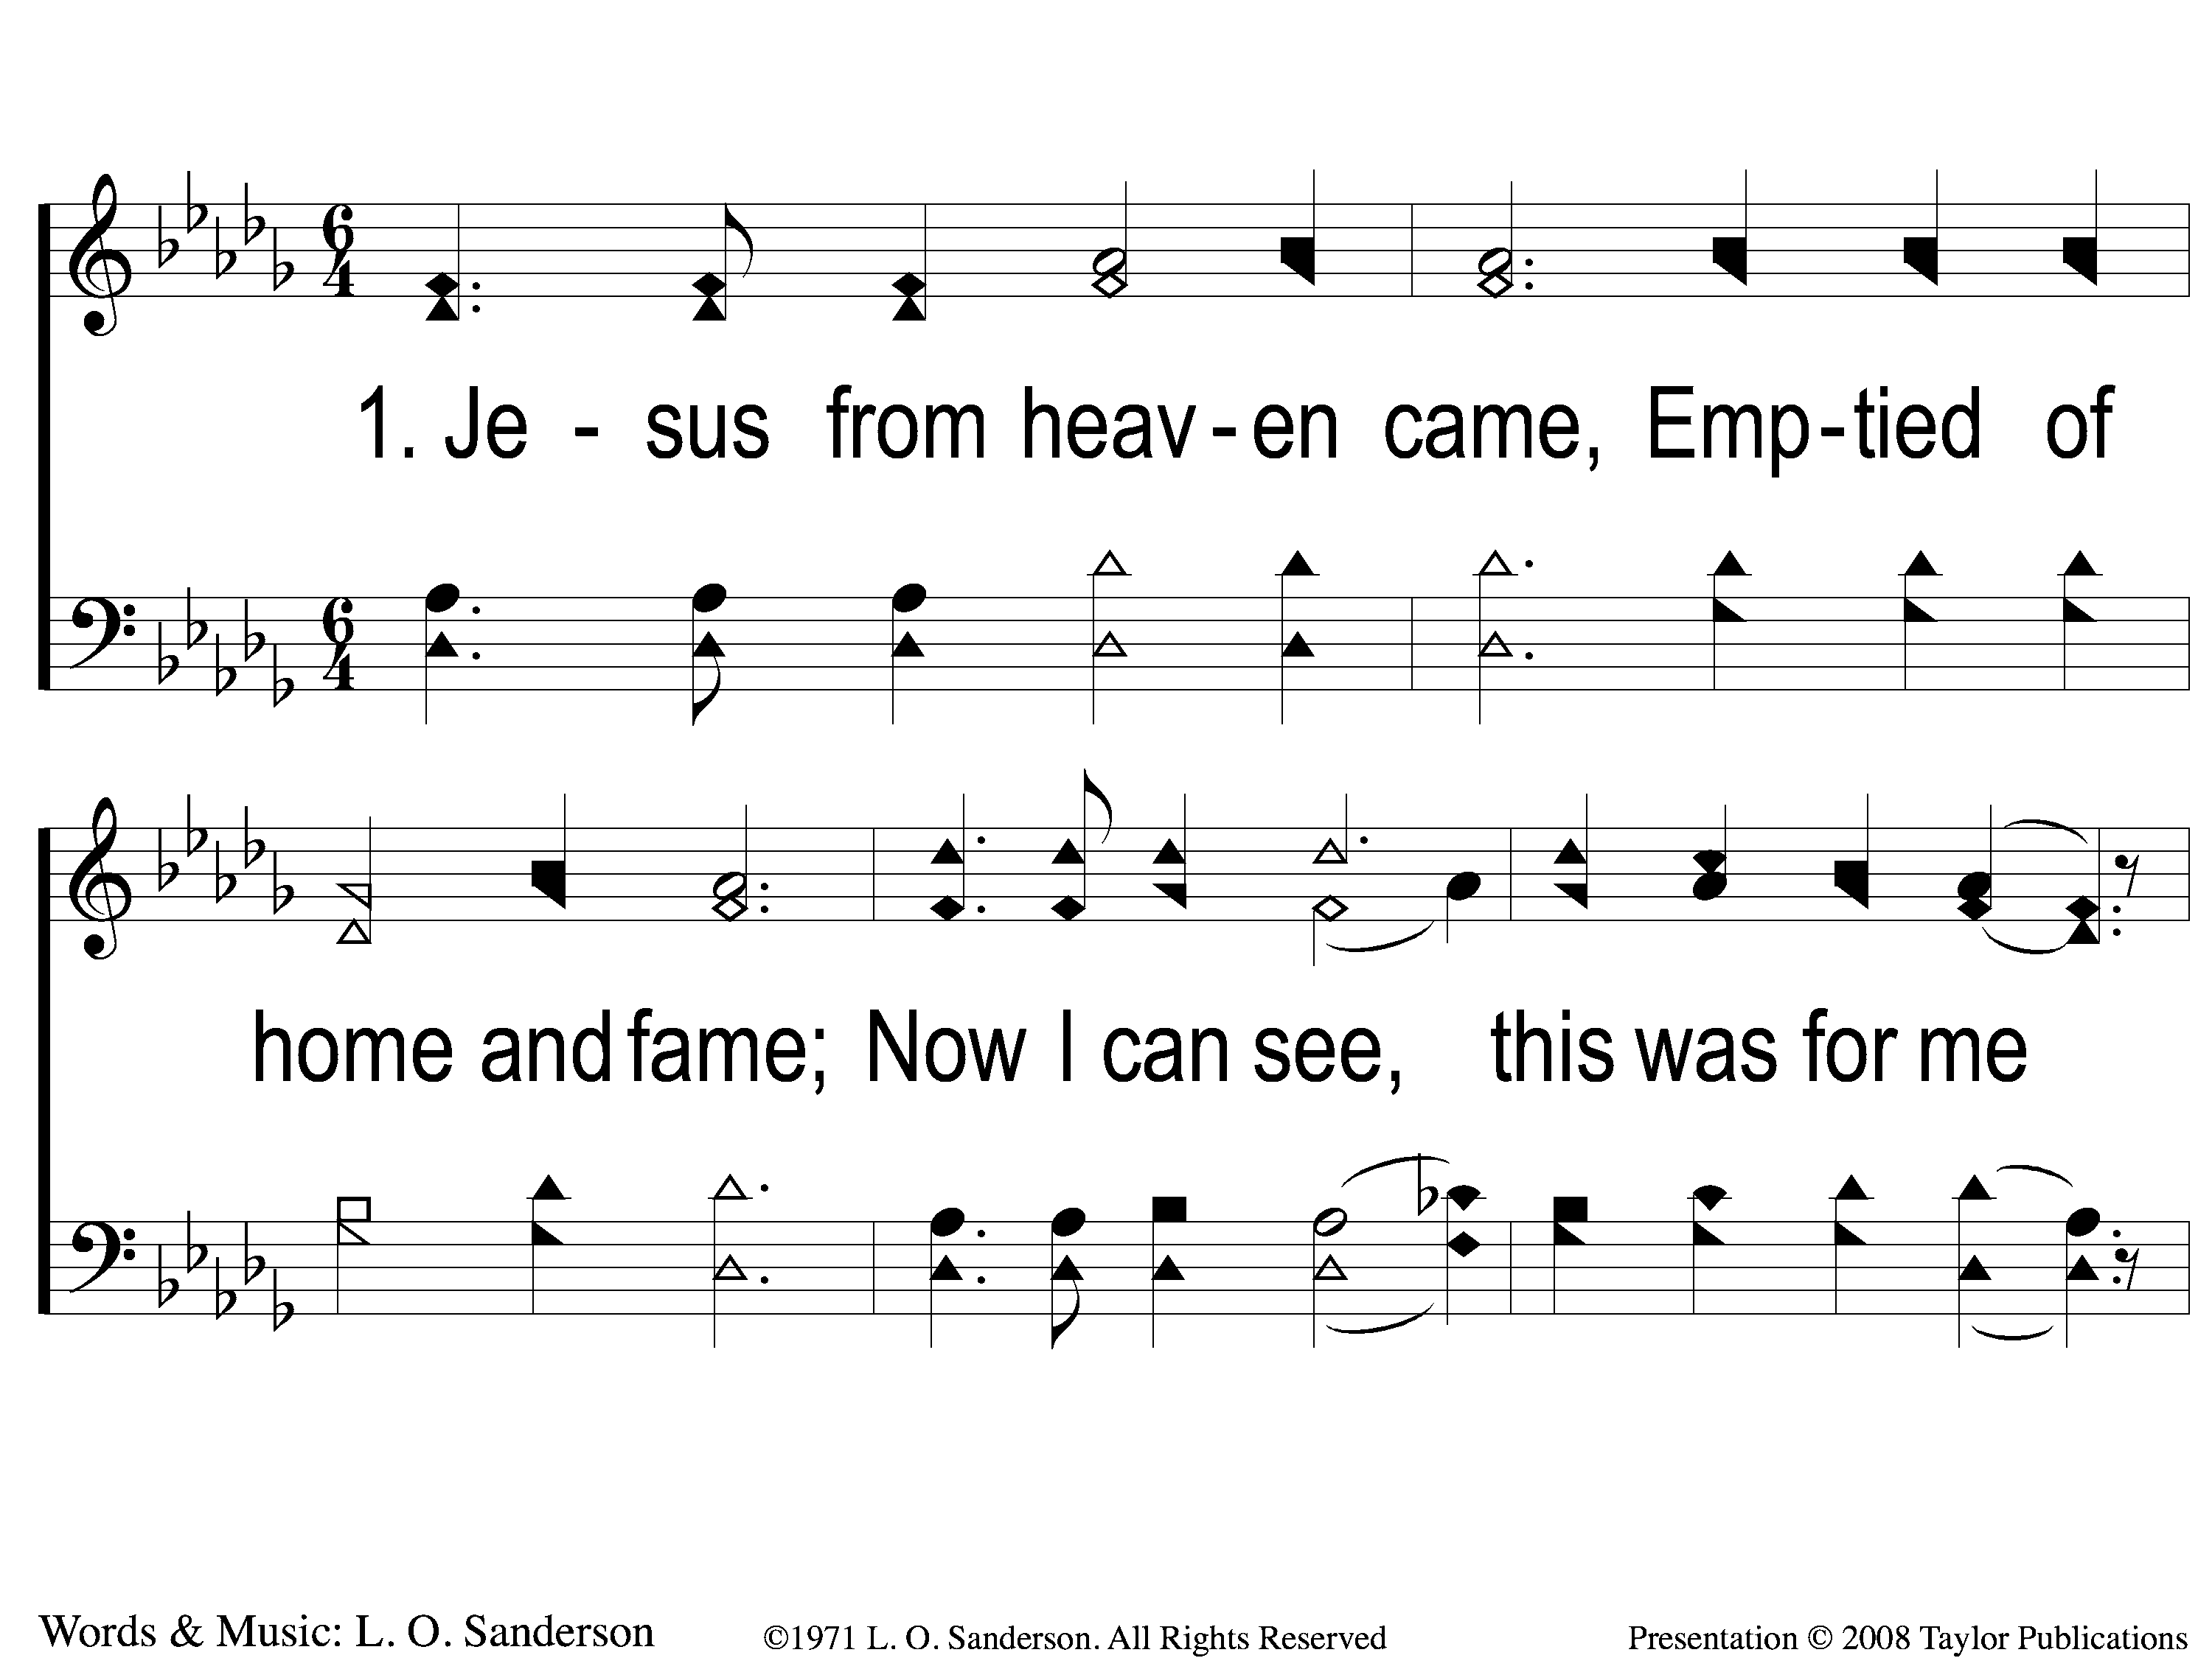
1-1 This is For Me
This is For Me
90

Slide 2
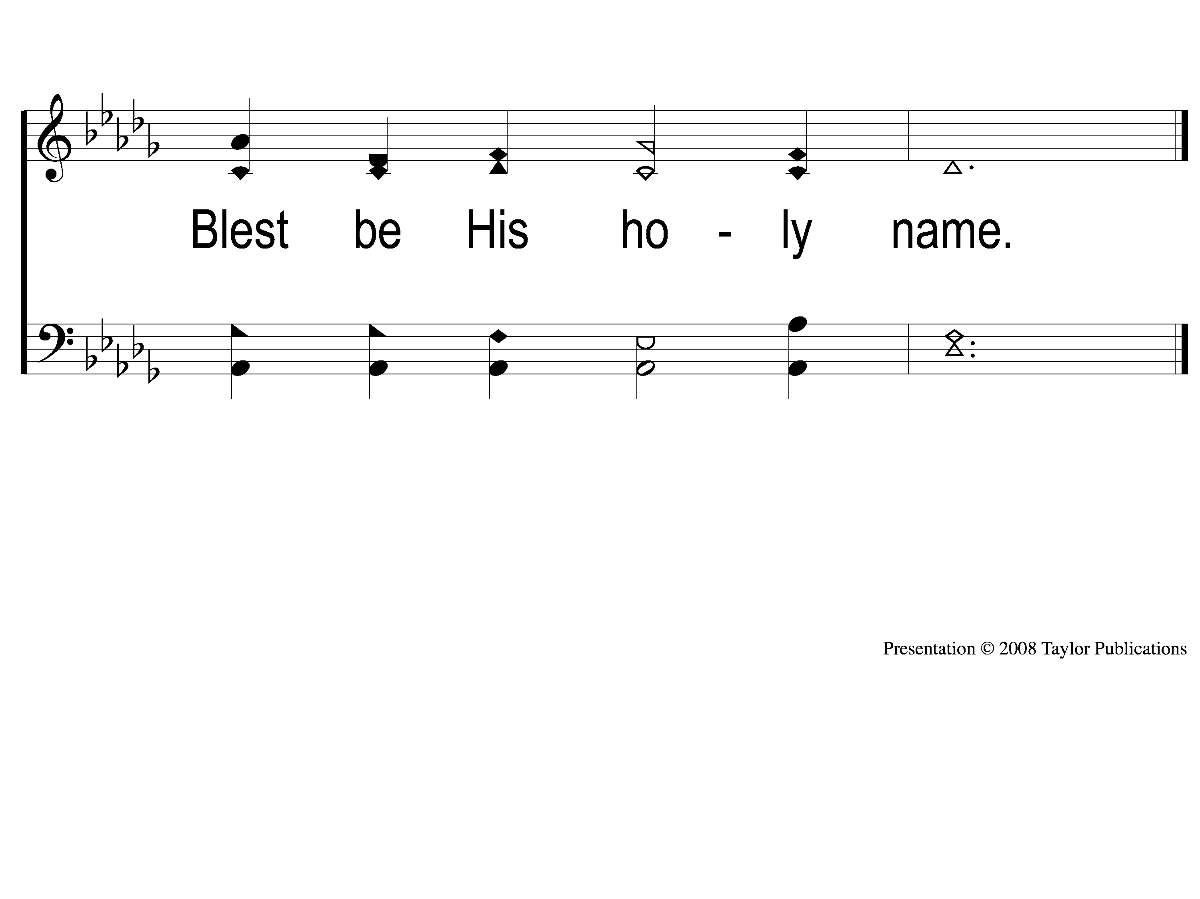
1-2 This is For Me
This is For Me
90

Slide 3
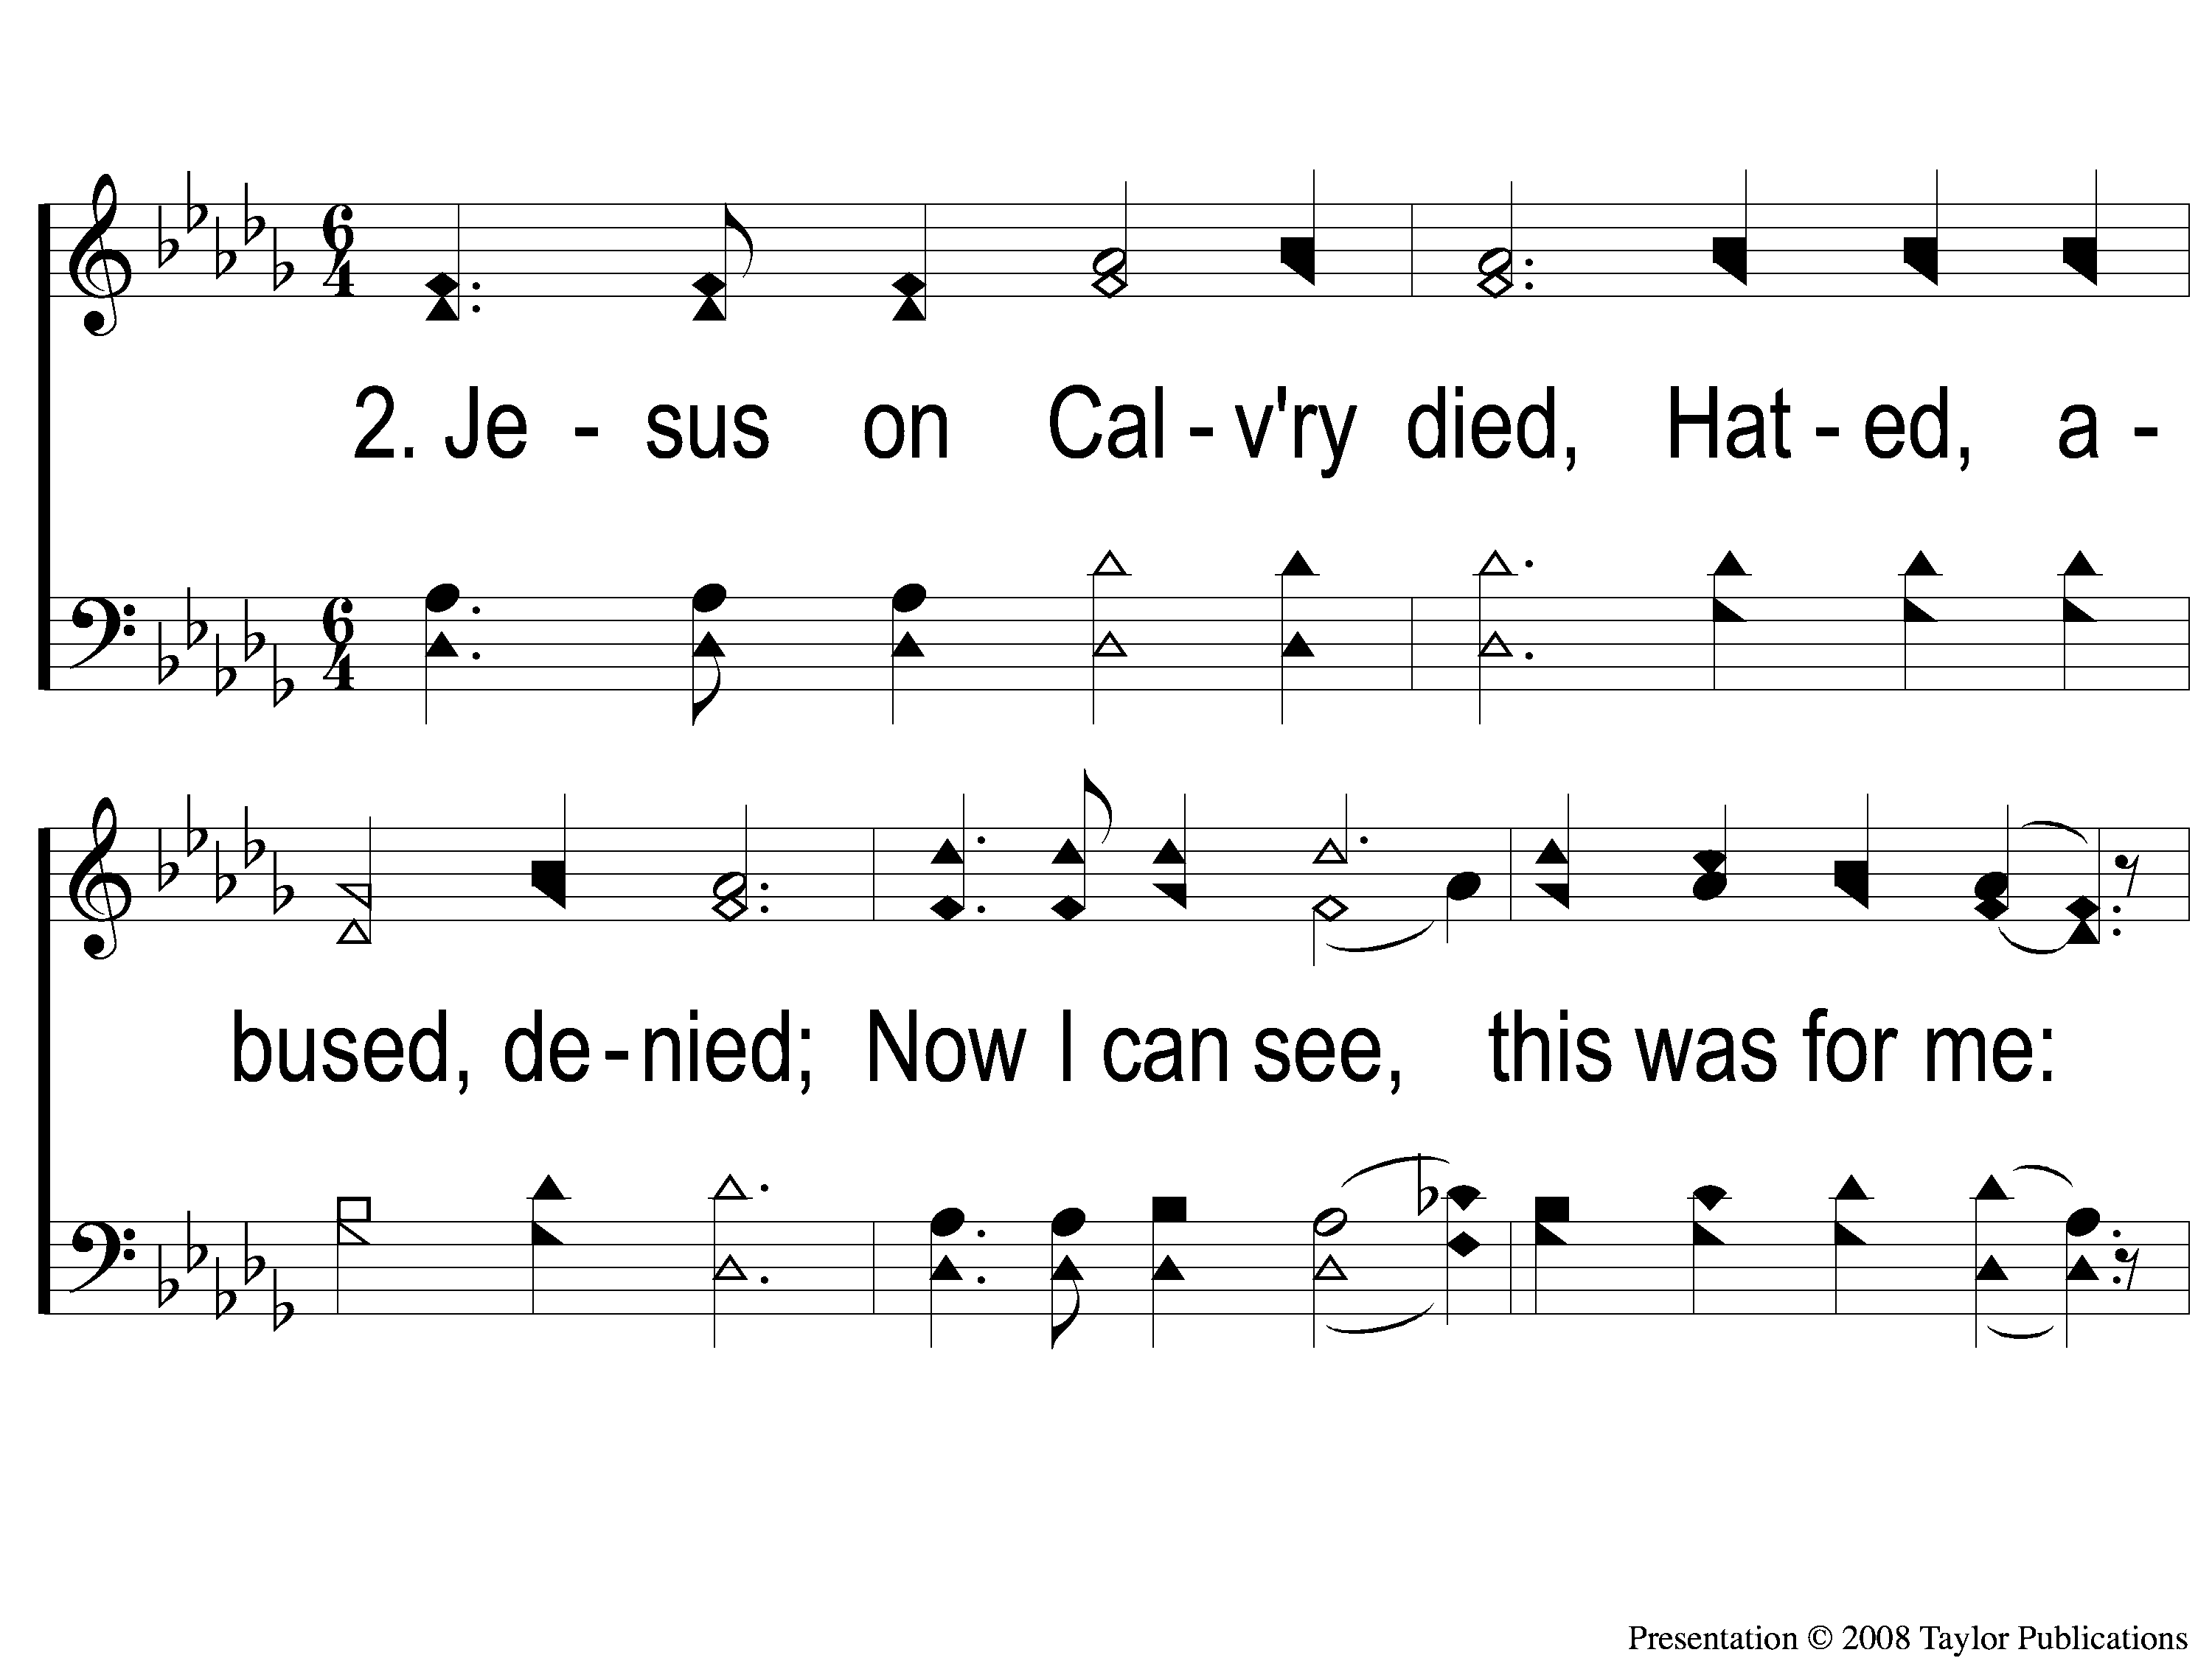
2-1 This is For Me
This is For Me
90

Slide 4
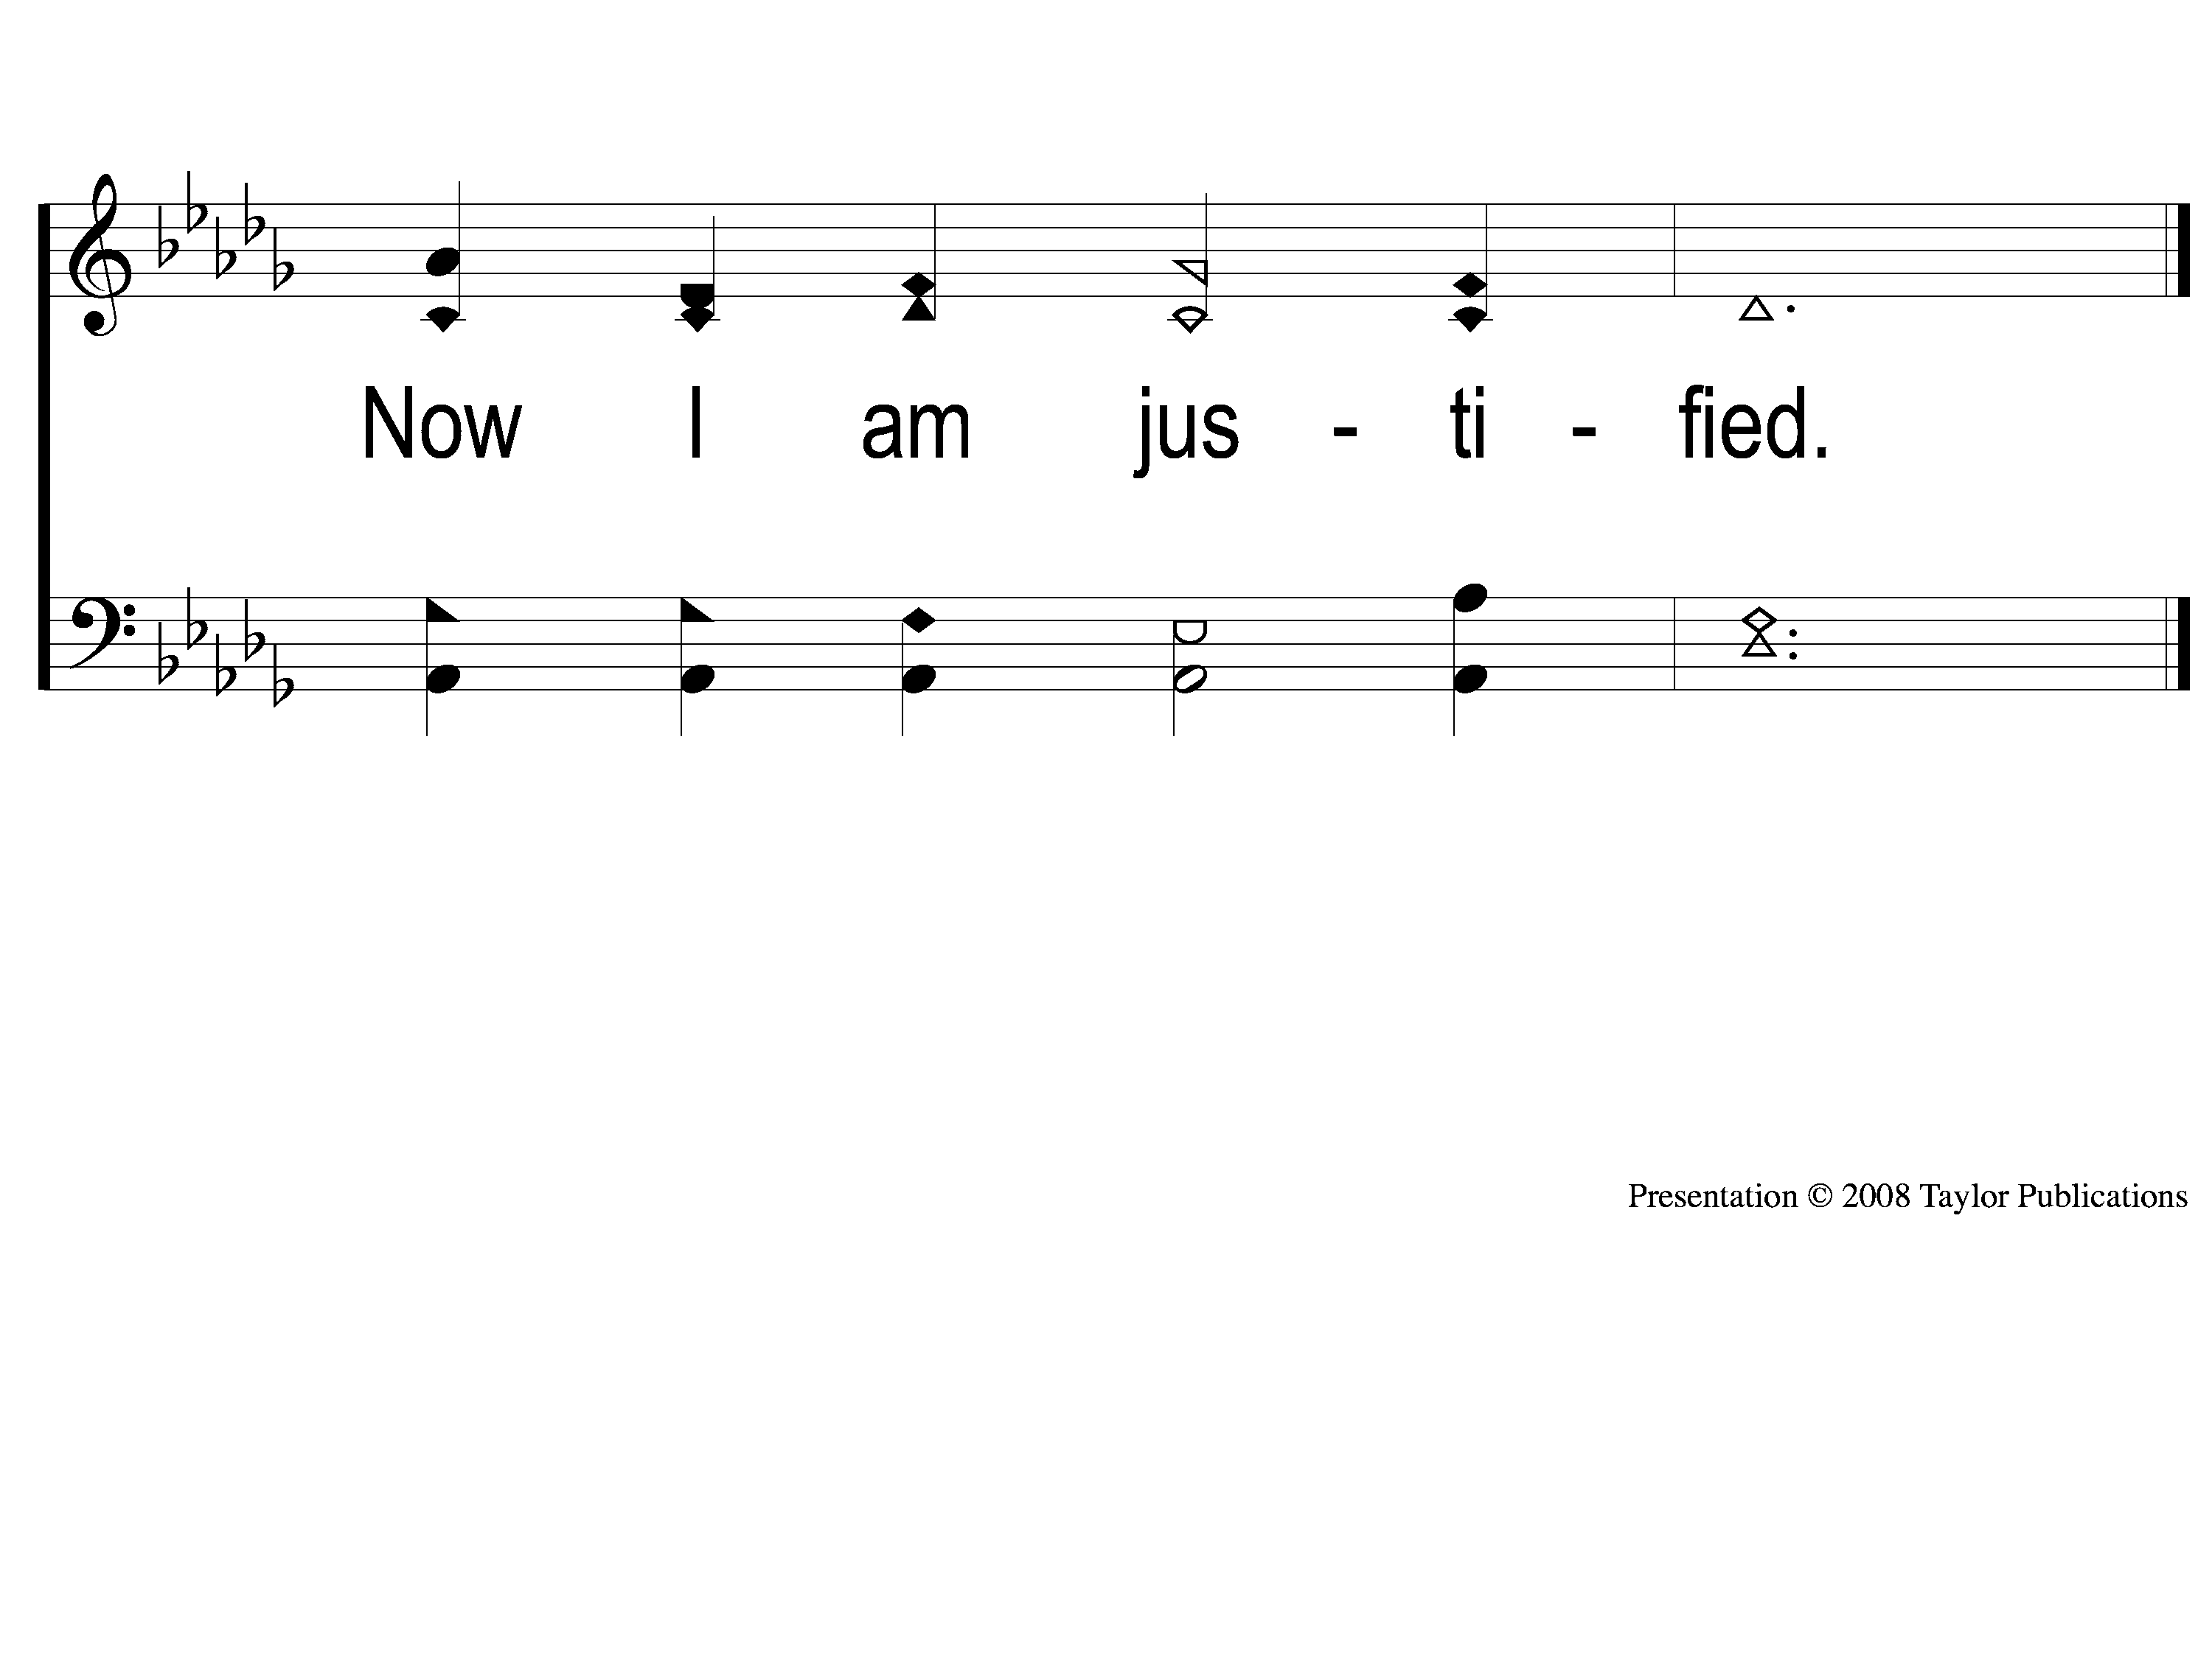
2-2 This is For Me
This is For Me
90

Slide 5
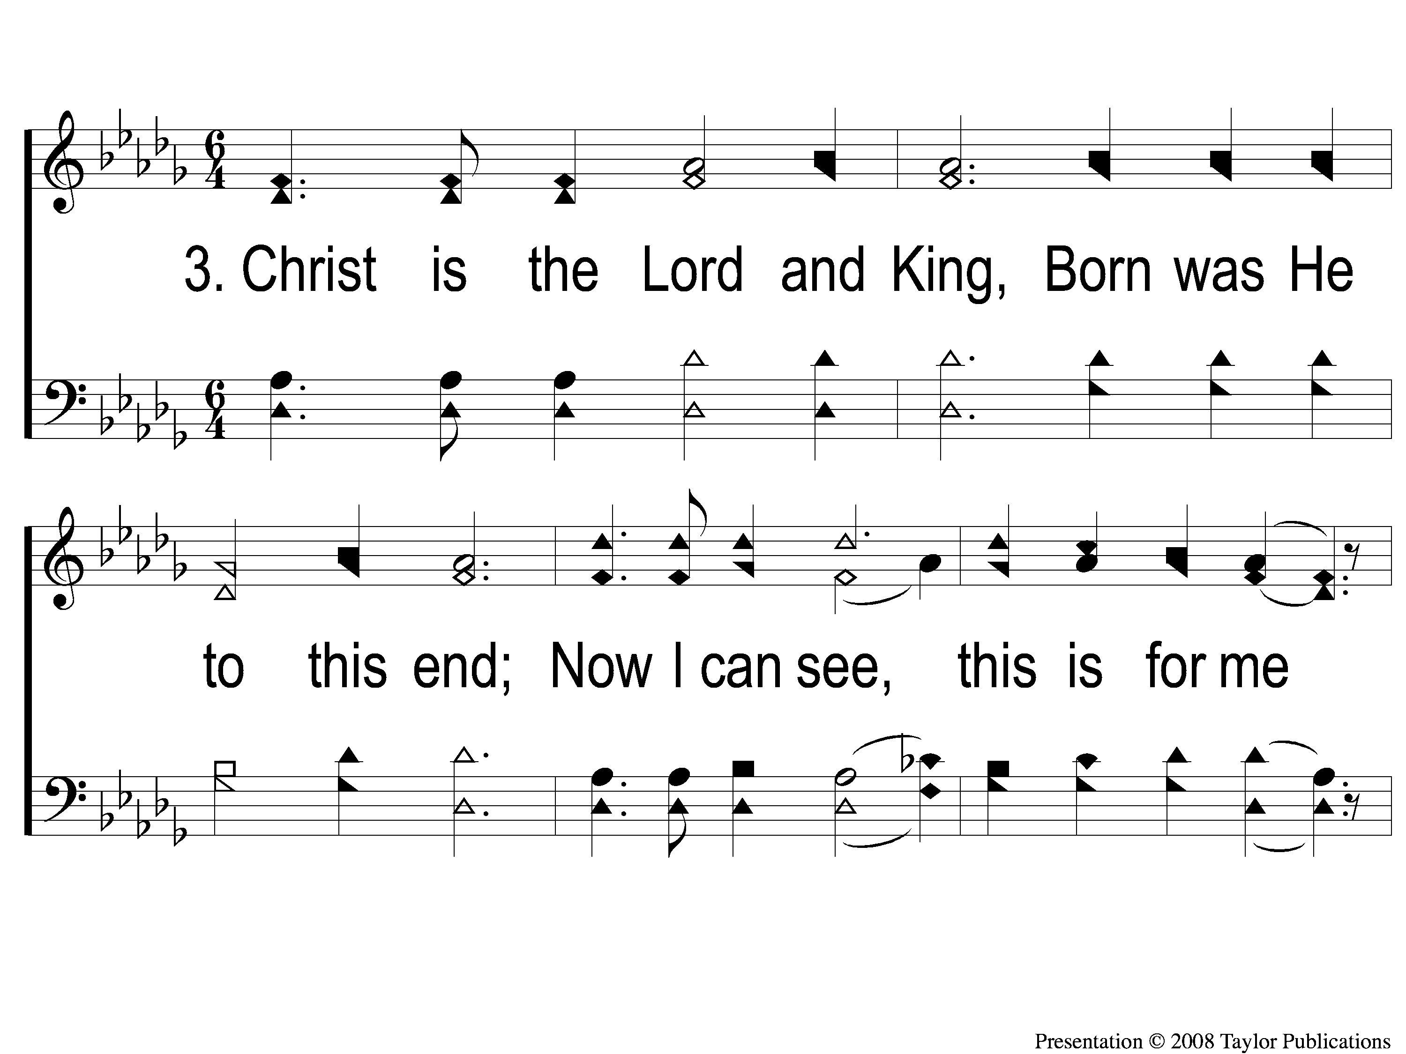
3-1 This is For Me
This is For Me
90

Slide 6
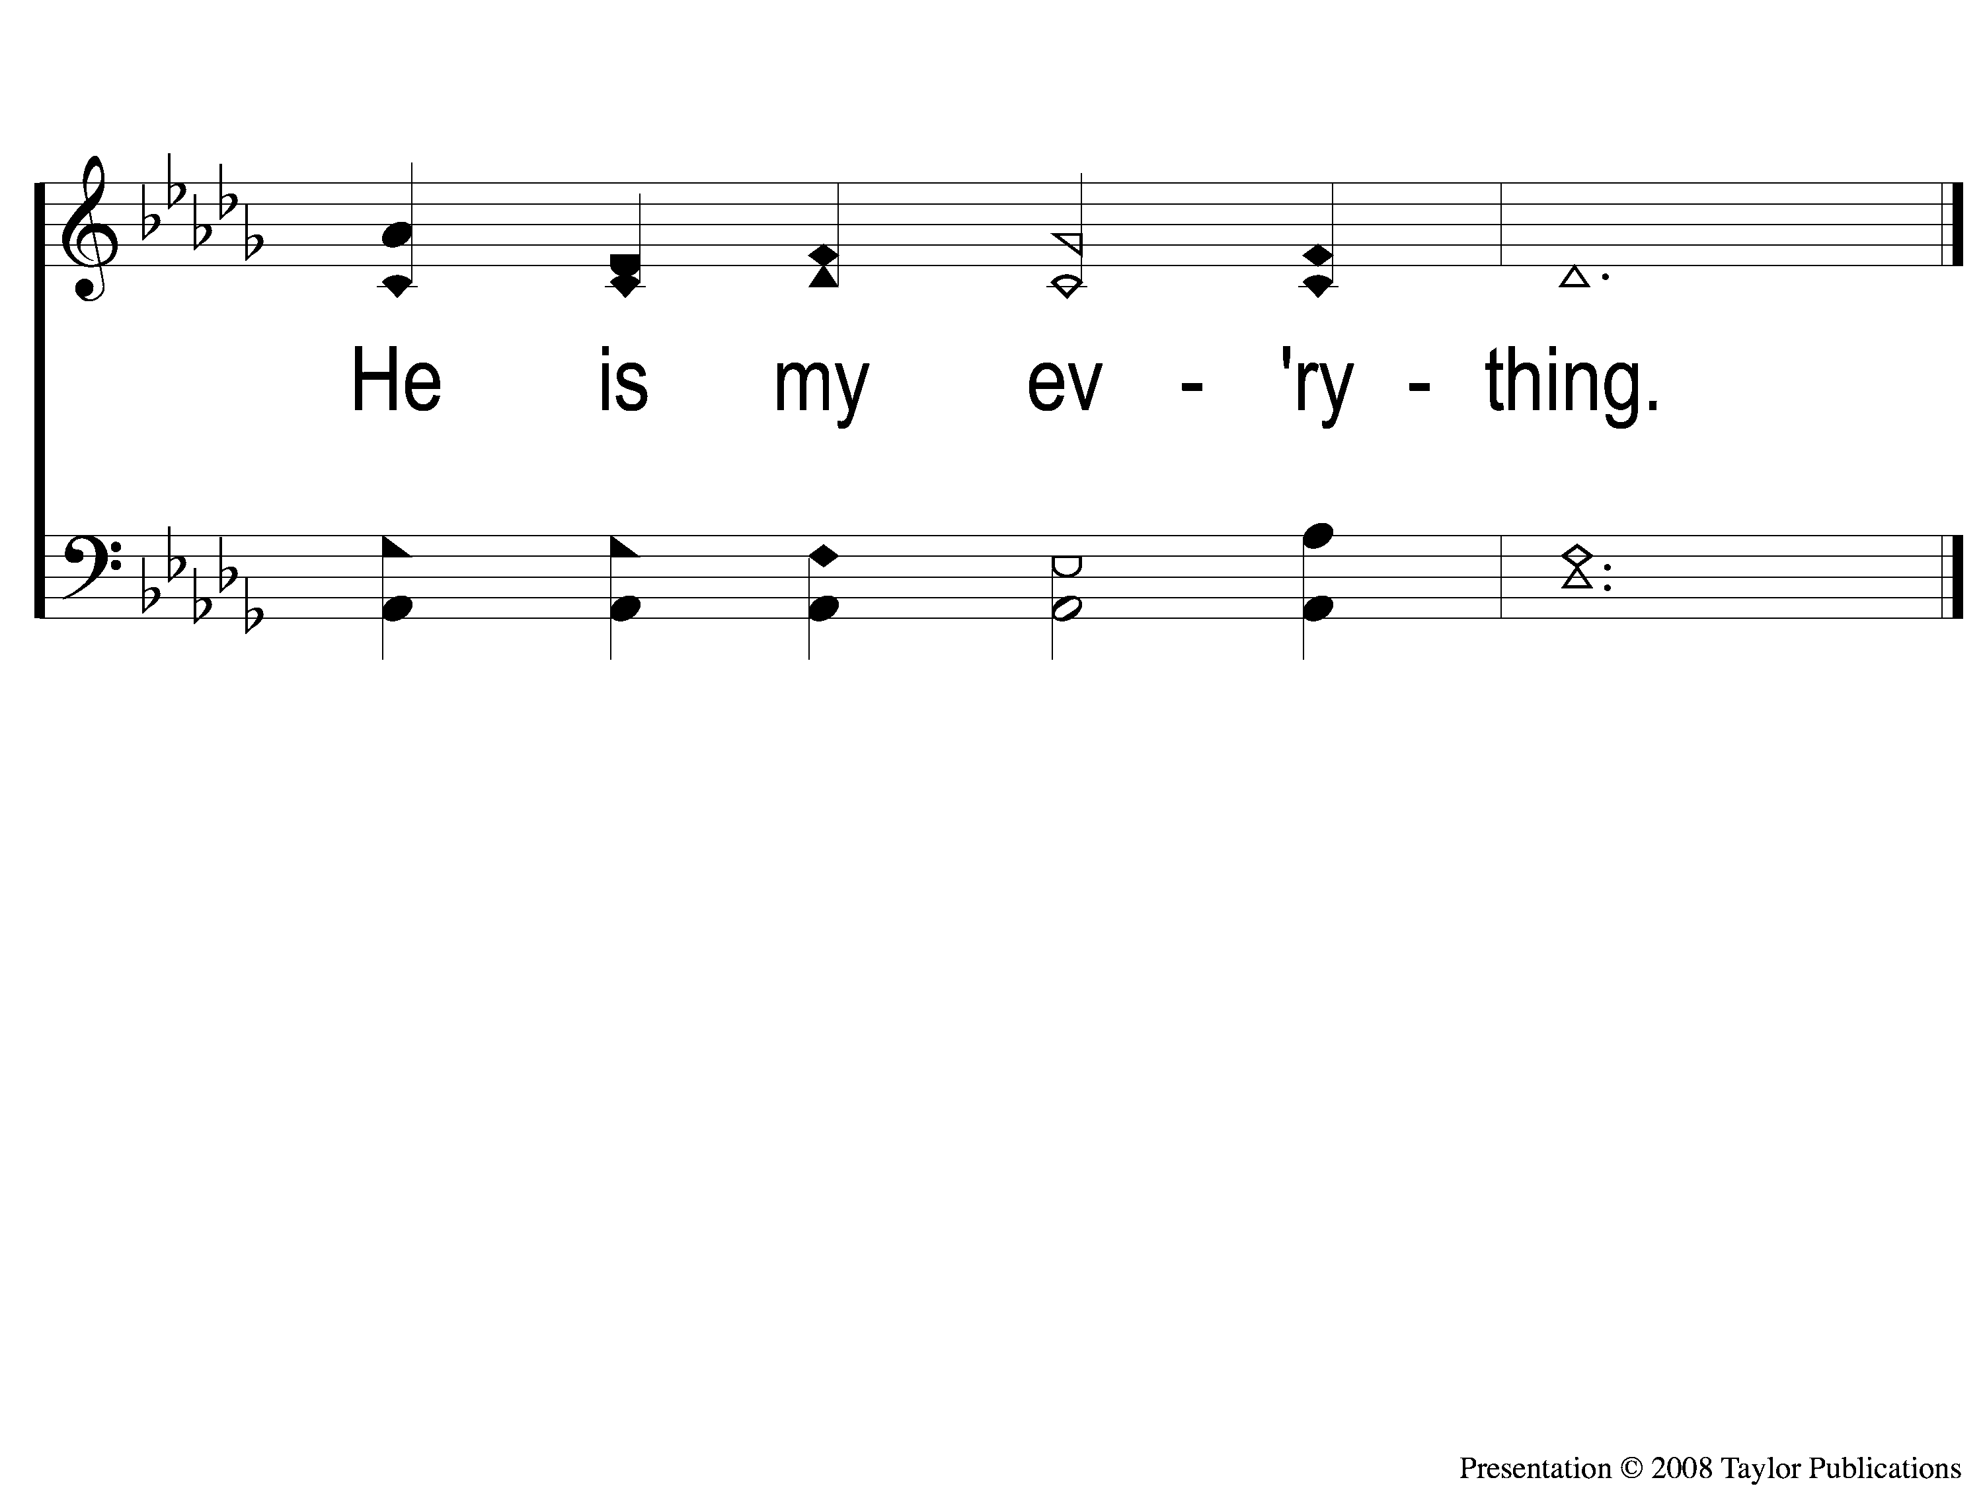
3-2 This is For Me
This is For Me
90

